Slide 1


Slide 2
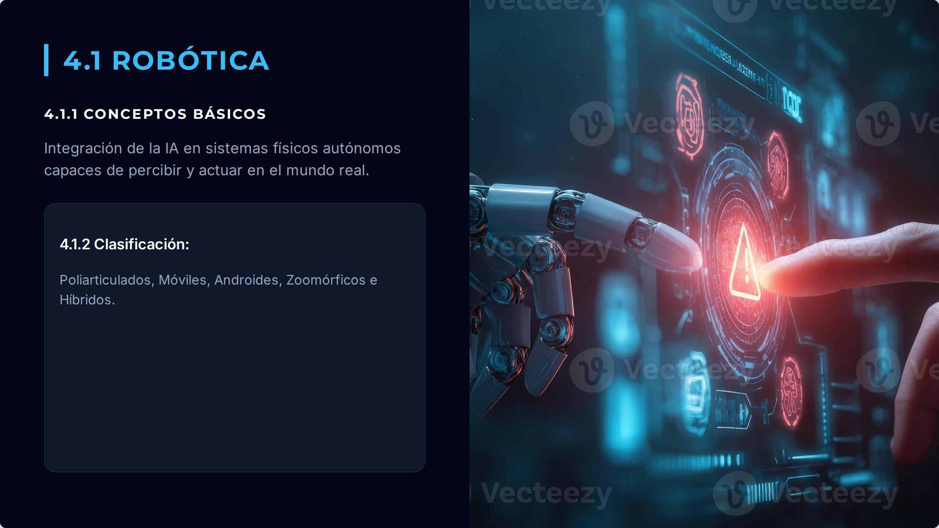

Slide 3
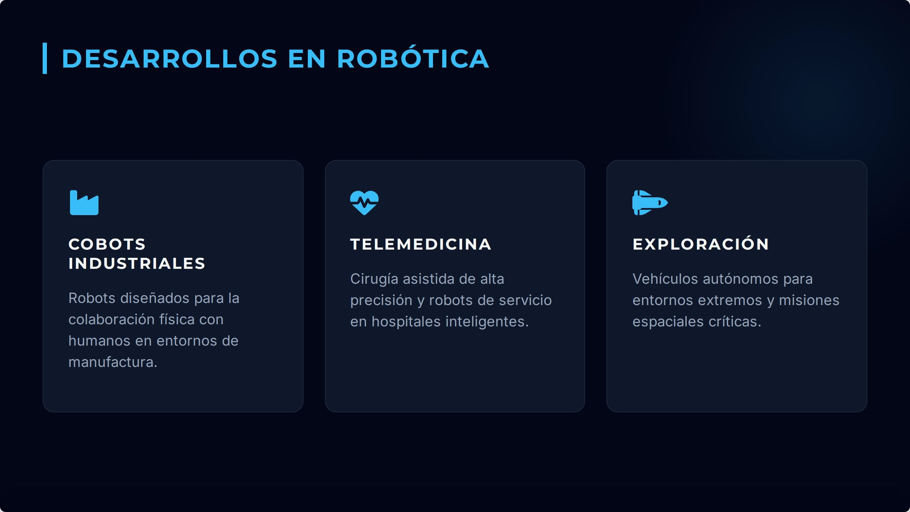

Slide 4
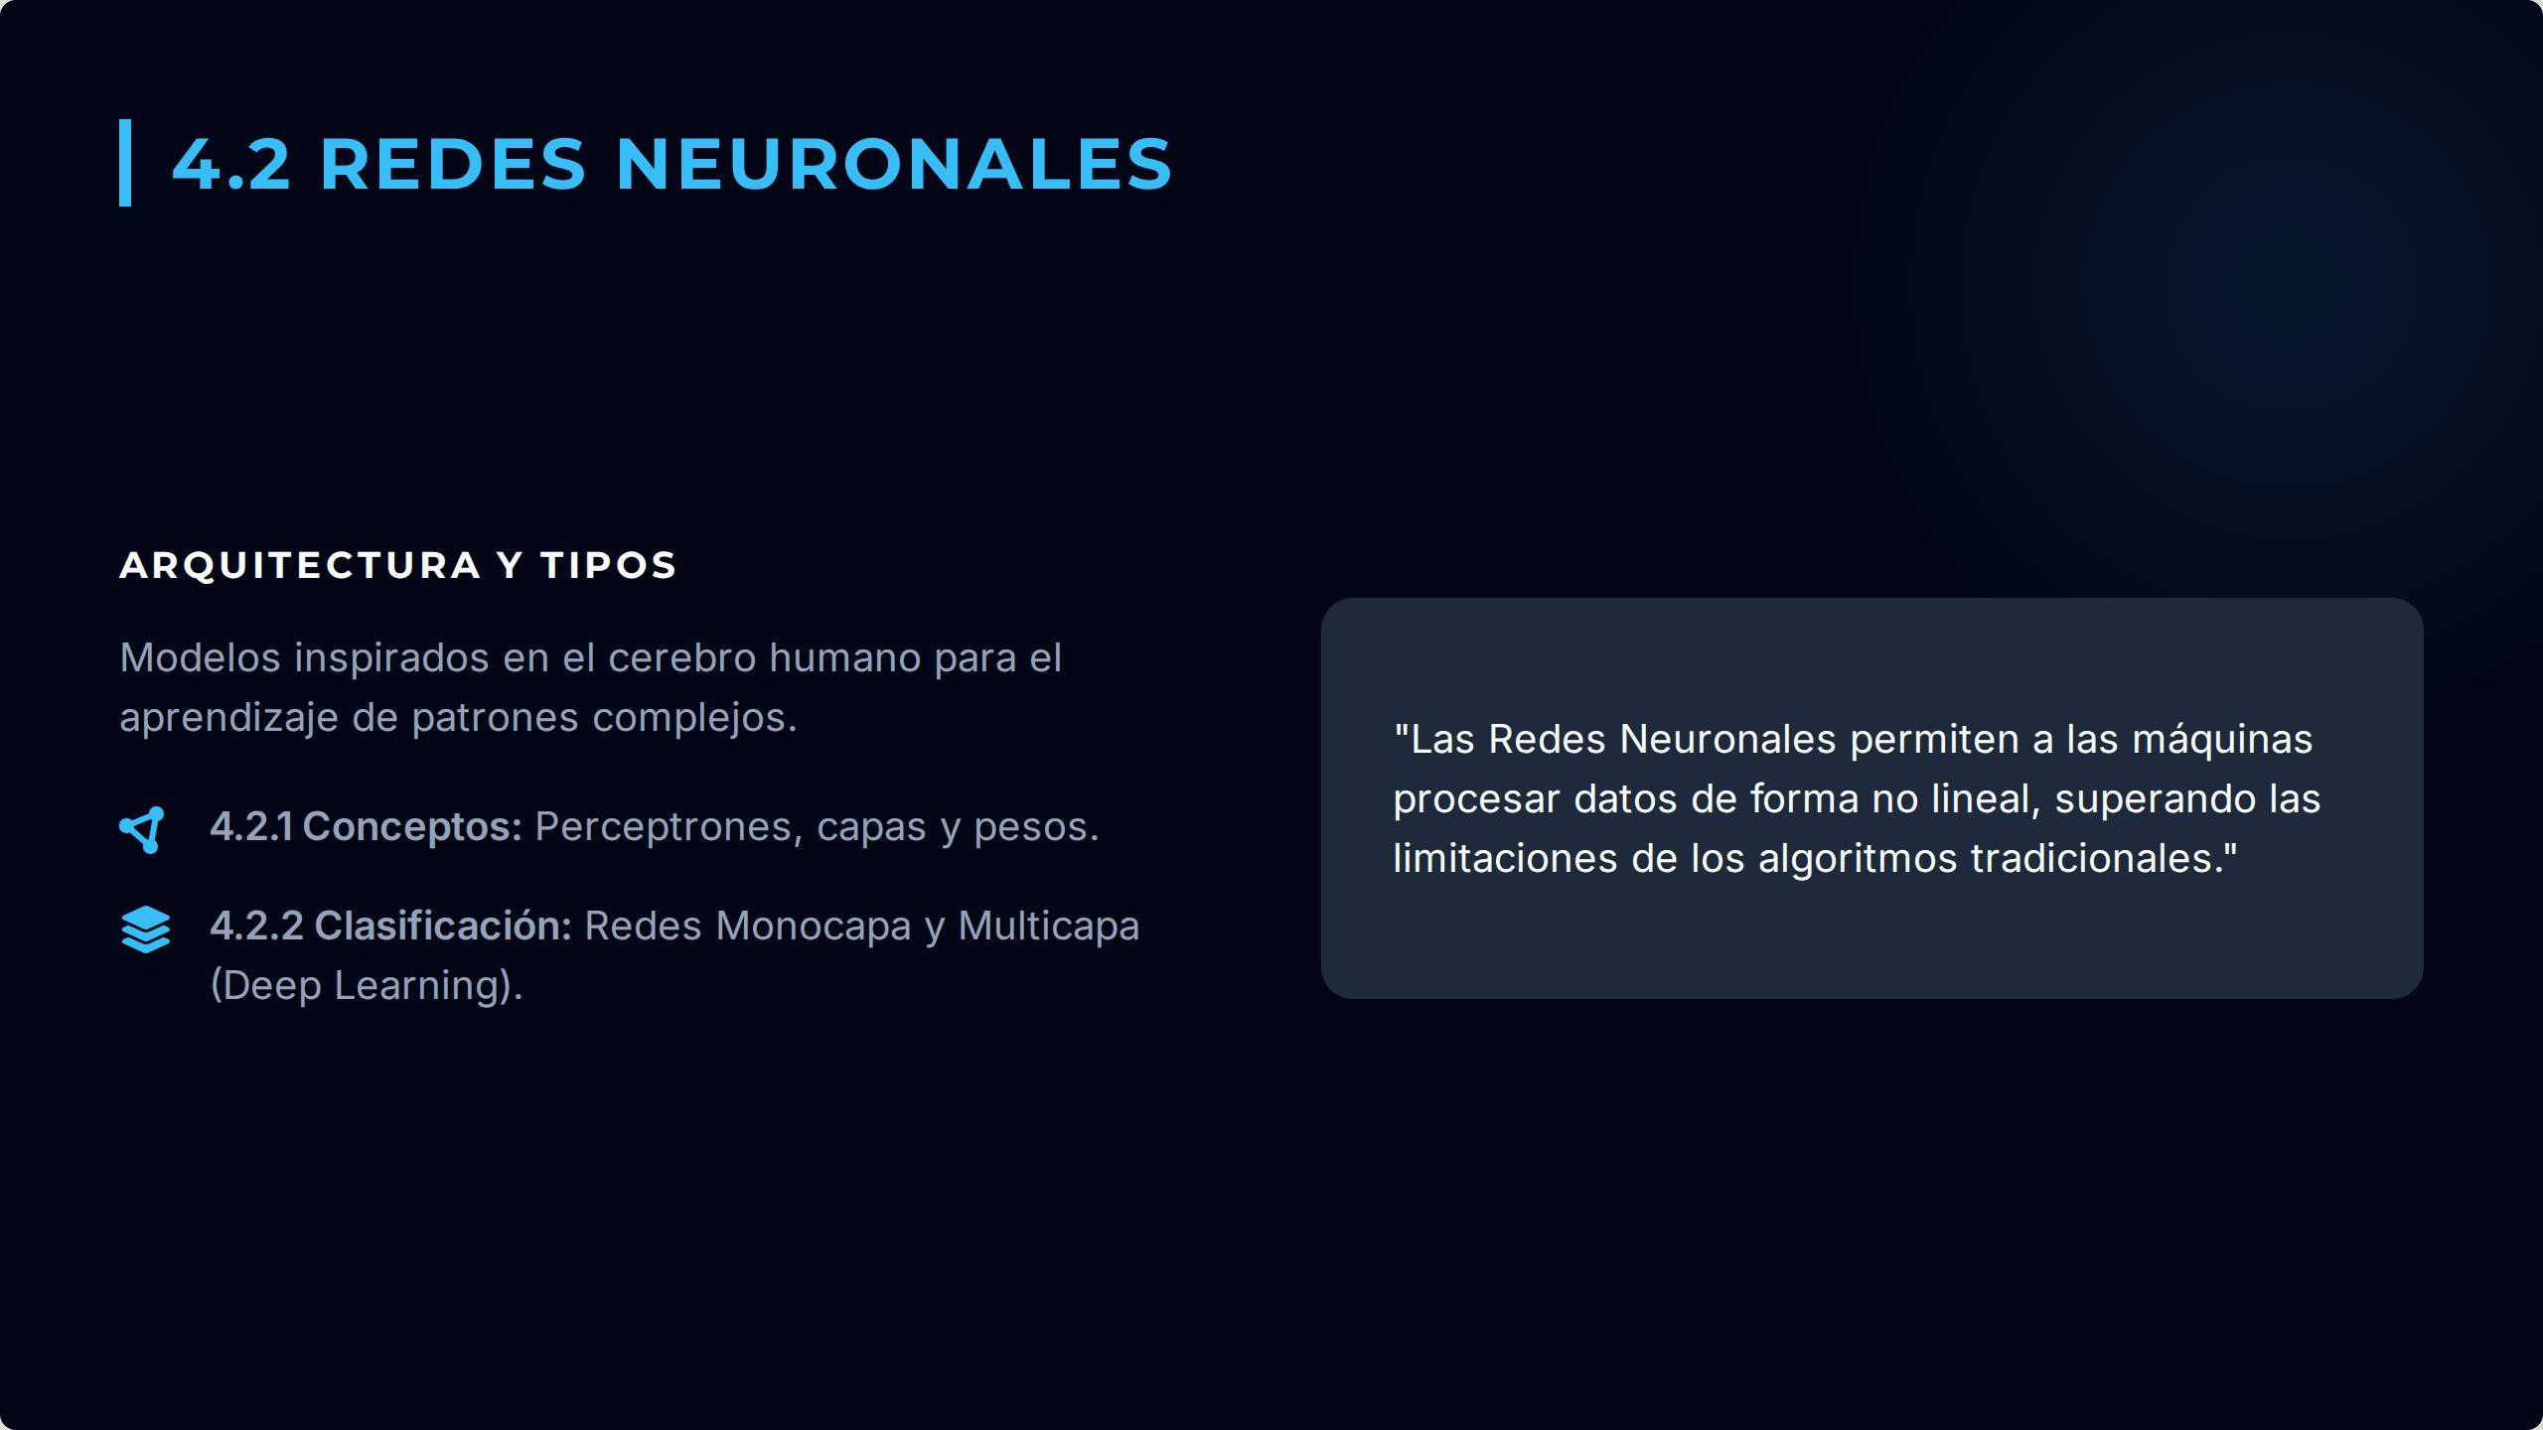

Slide 5
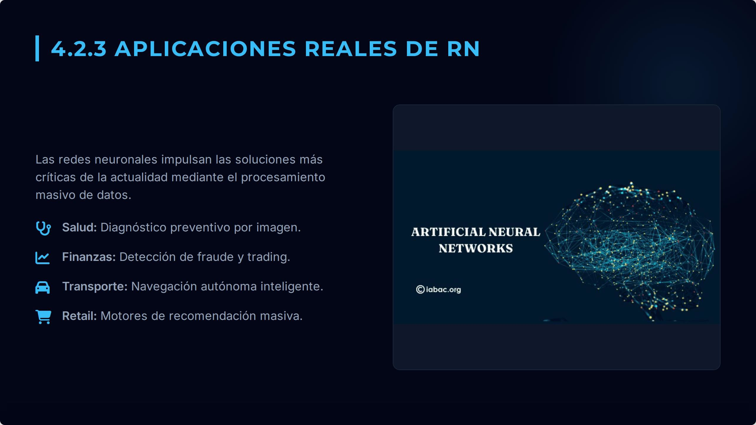

Slide 6
Models and their Real-world APF
tectio
_I

Slide 7
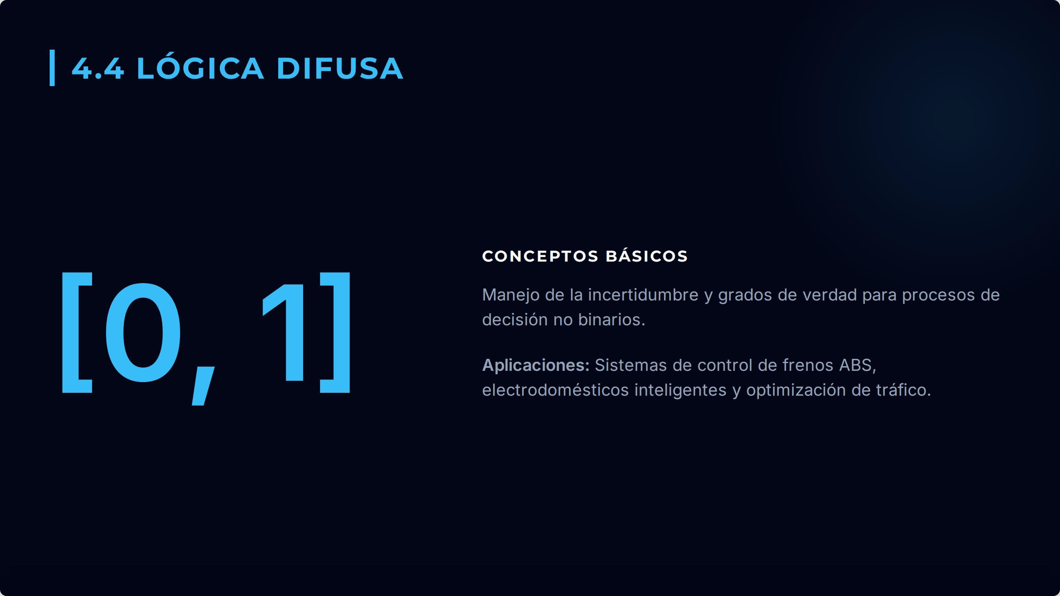

Slide 8
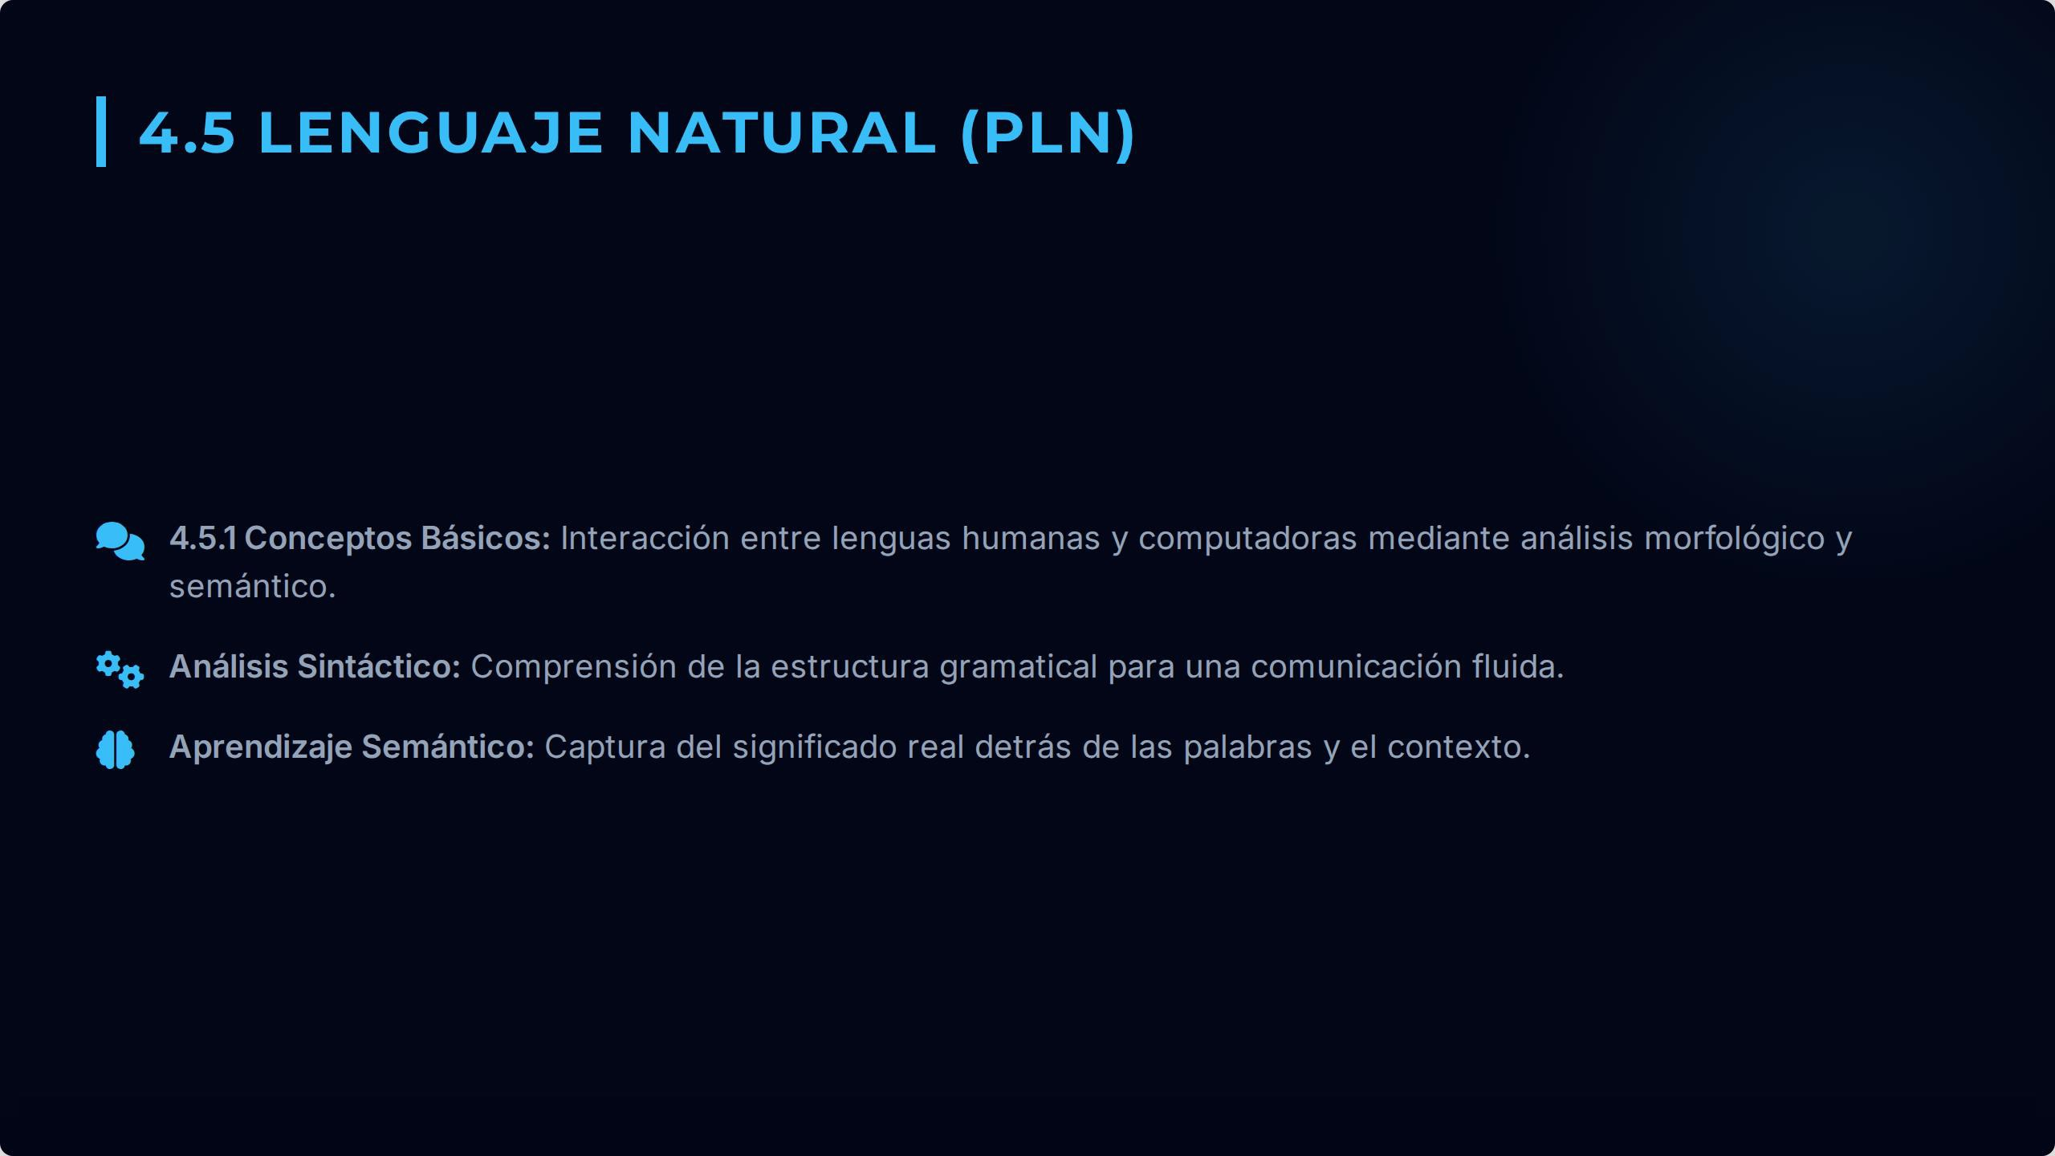

Slide 9


Slide 10
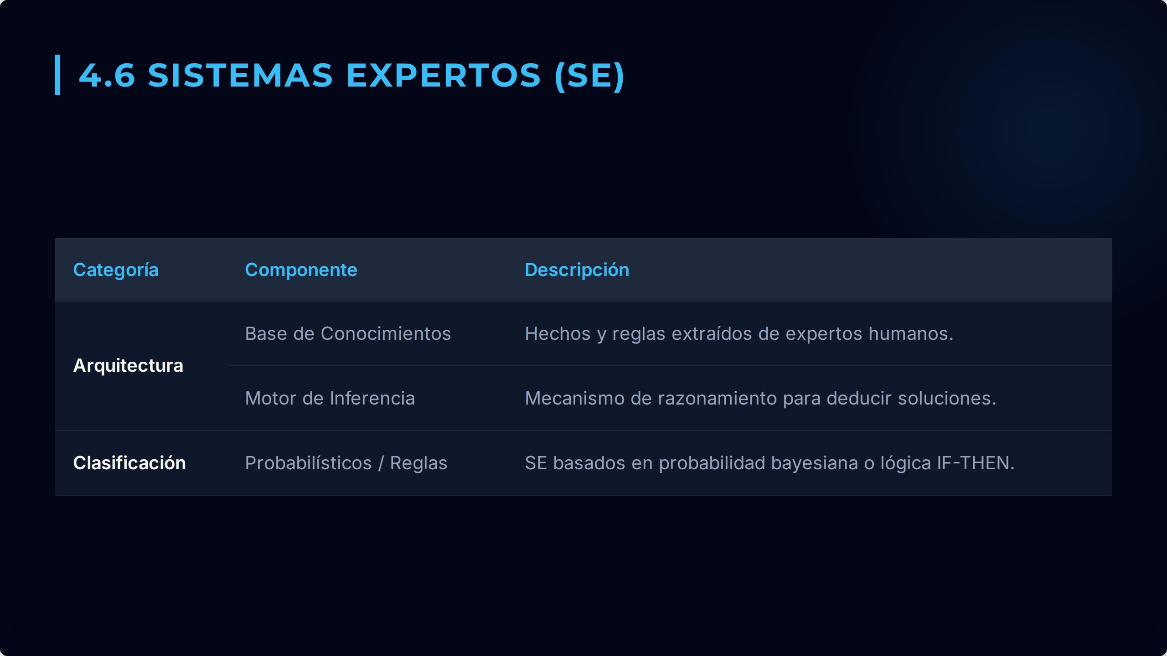

Slide 11

95%
82%
88%
Sistemas Expertos
65%

Slide 12


